Slide 1

Data Storytelling Project
Drug Poisoning Mortality by State:United States
Made By:
Monish Gosar (J025)
Atharva Rode(J056)
Kallind Soni(J065)
Prsni Kanani(J073)

Slide 2
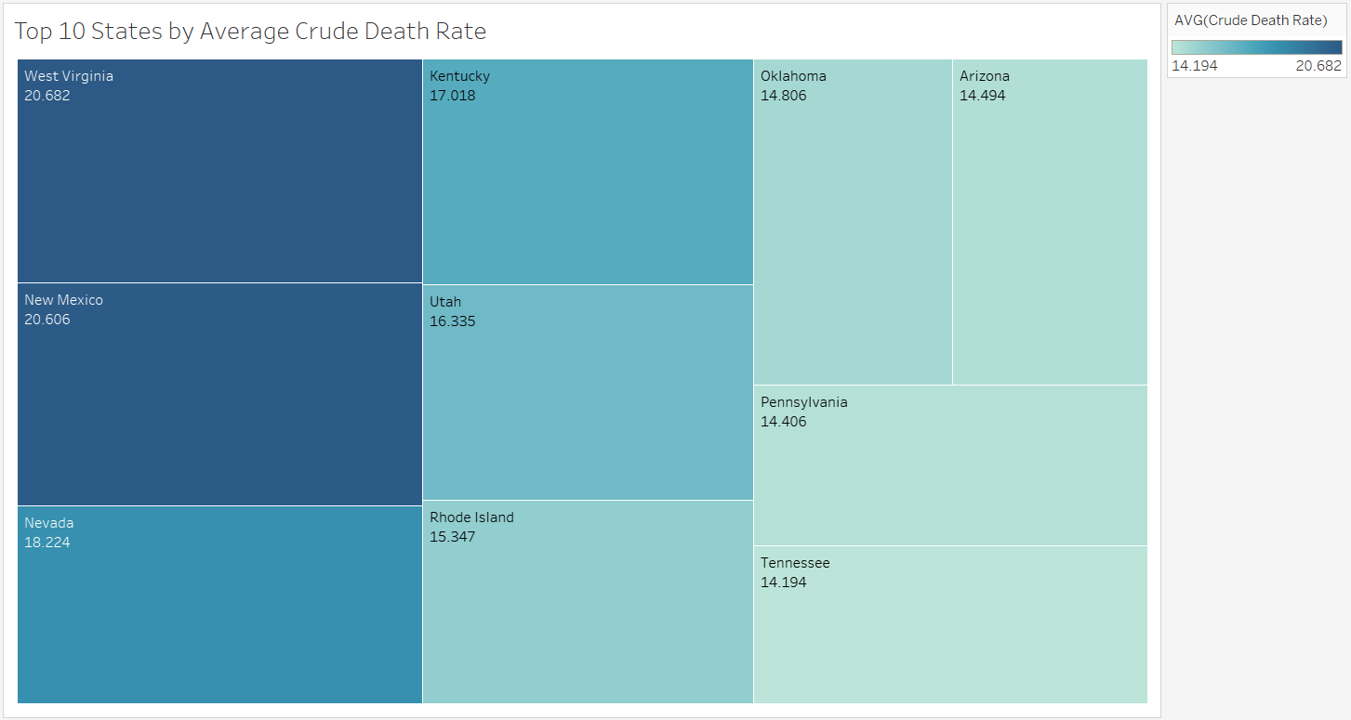

Slide 3
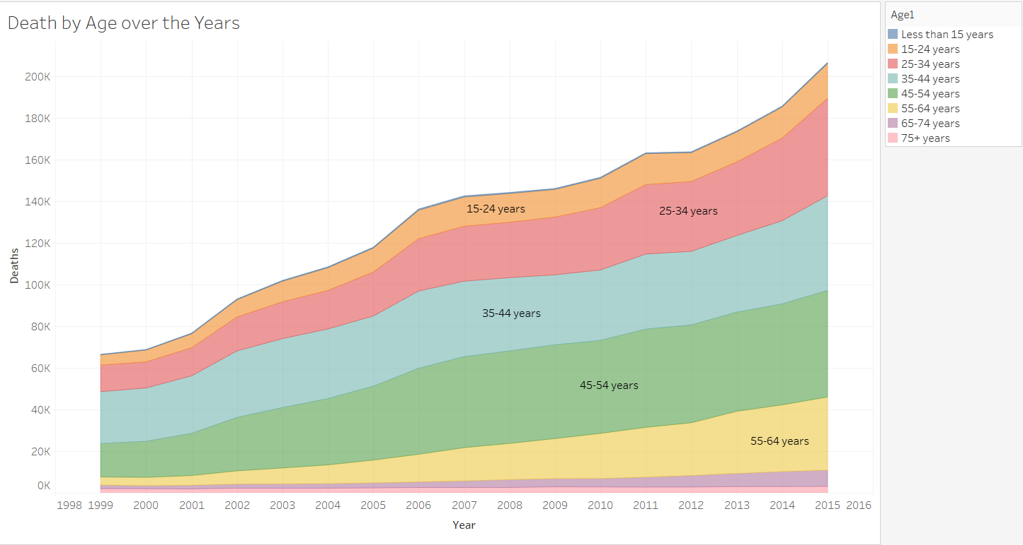

Slide 4
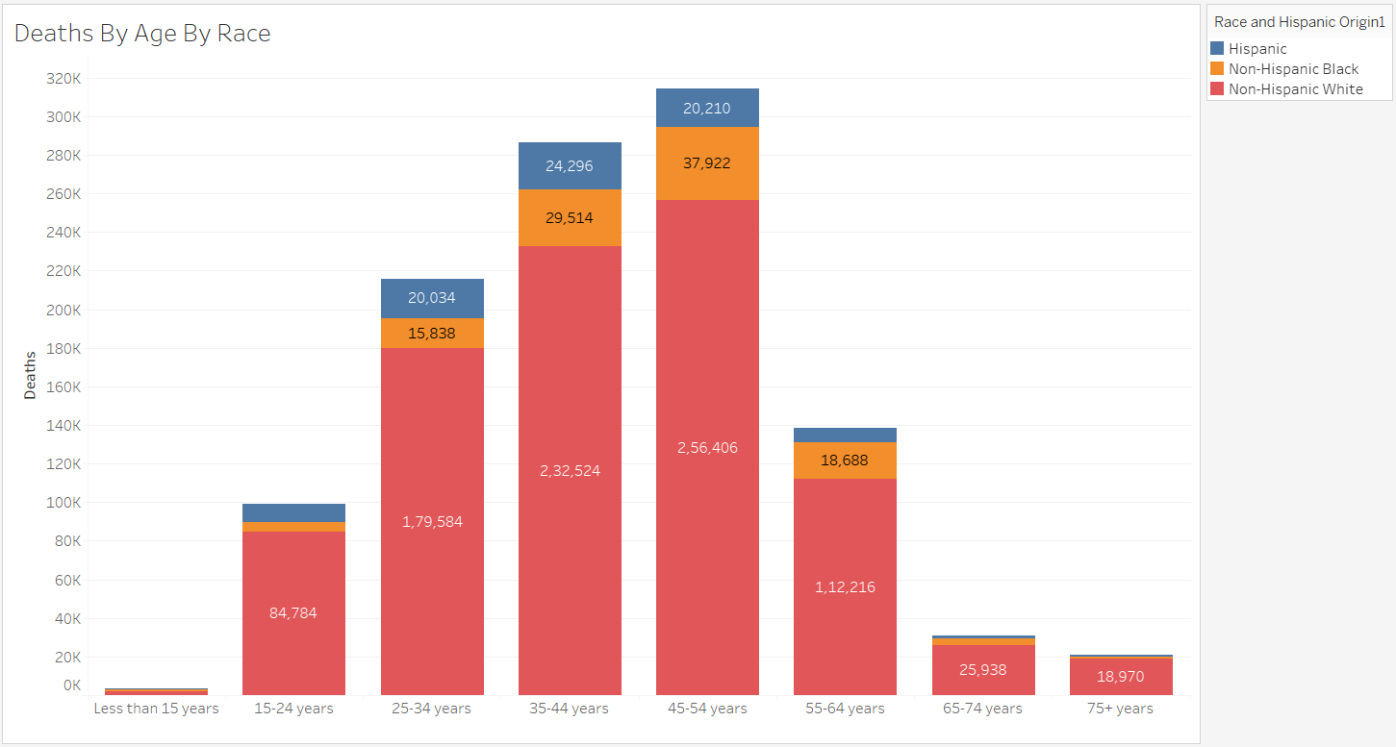

Slide 5
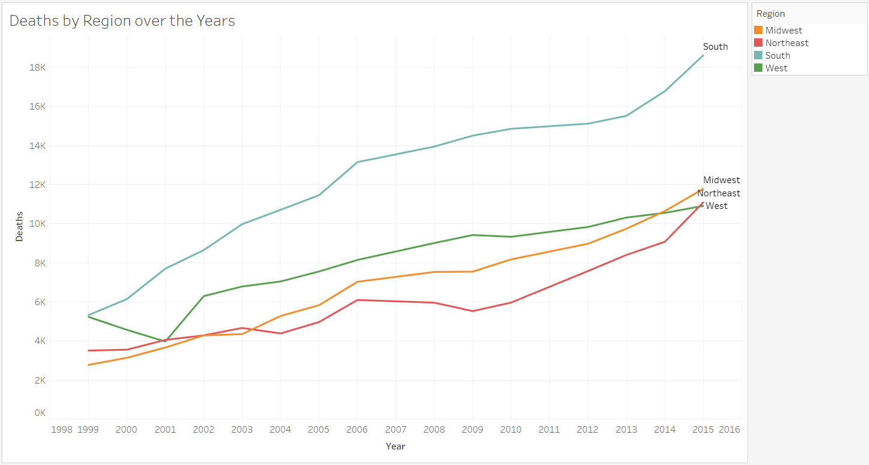

Slide 6
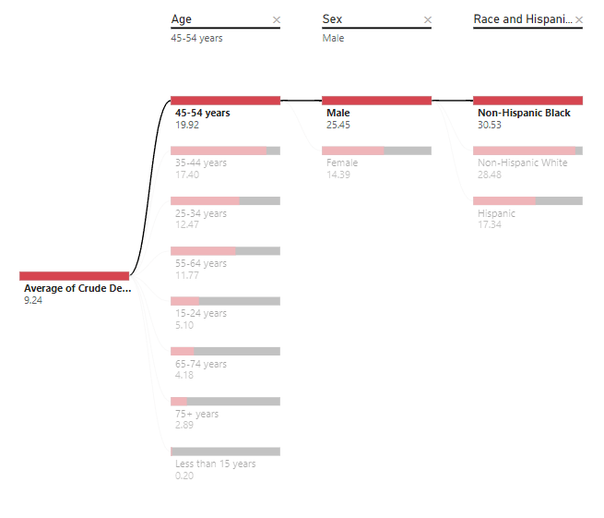
Decomposition Tree - Combination of Age,Sex and Race showing Highest Crude Death Rate

Slide 7
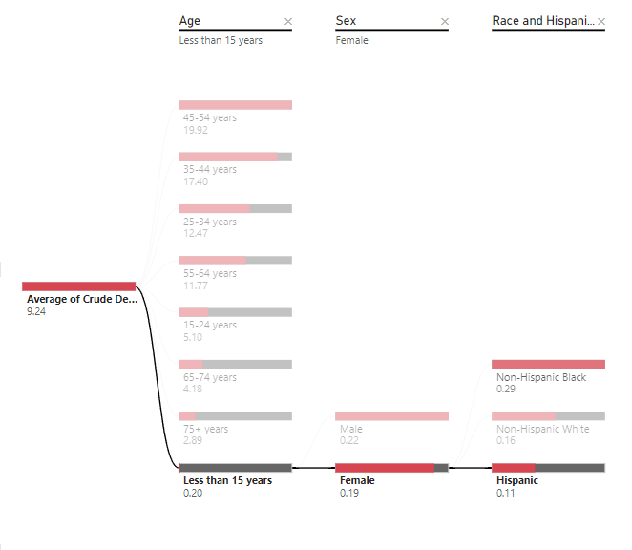
Decomposition Tree - Combination of Age,Sex and Race showing Lowest Crude Death Rate

Slide 8
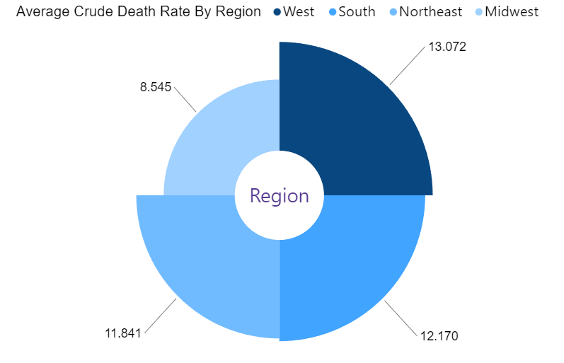

Slide 9
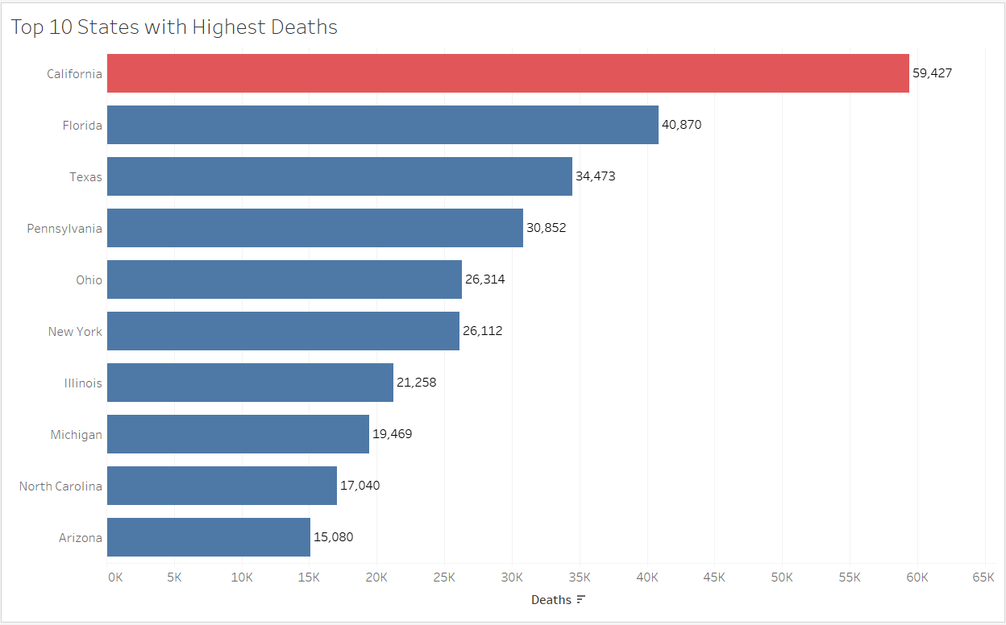

Slide 10
Thank You!
Made By:
Monish Gosar (J025)
Atharva Rode(J056)
Kallind Soni(J065)
Prsni Kanani(J073)

